Slide 1
Tree data structures
Introduction

Slide 2
Tree Data Structure
A tree is a nonlinear hierarchical data structure that consists of nodes connected by edges.
Other data structures such as arrays, linked list, stack, and queue are linear data structures that store data sequentially. In order to perform any operation in a linear data structure, the time complexity increases with the increase in the data size. But, it is not acceptable in today's computational world.
Different tree data structures allow quicker and easier access to the data as it is a non-linear data structure.

Slide 3
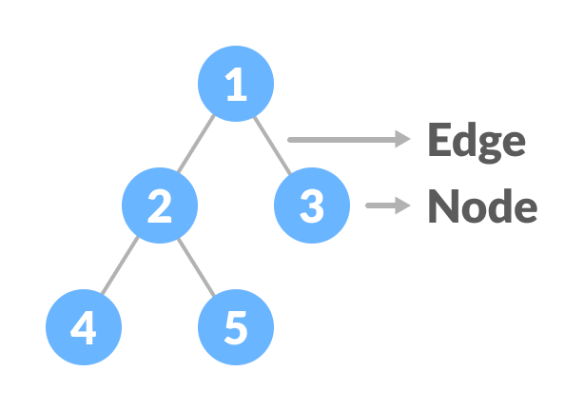
Tree Terminologies
Node
A node is an entity that contains a key or value and pointers to its child nodes.
The last nodes of each path are called leaf nodes or external nodes that do not contain a link/pointer to child nodes.
The node having at least a child node is called an internal node.
Edge
It is the link between any two nodes.
Root
It is the topmost node of a tree.
Degree of a Node
The degree of a node is the total number of branches of that node.
Root

Slide 4
Types of Tree
BINARY TREE
BINARY SEARCH TREE
B-TREE
AVL TREE

Slide 5
Tree Applications
Binary Search Trees(BSTs) are used to quickly check whether an element is present in a set or not.
Heap is a kind of tree that is used for heap sort.
A modified version of a tree called Tries is used in modern routers to store routing information.
Most popular databases use B-Trees and T-Trees, which are variants of the tree structure we learned above to store their data
Compilers use a syntax tree to validate the syntax of every program you write.

Slide 6
Tree Traversal - inorder, preorder and postorder
Traversing a tree means visiting every node in the tree. You might, for instance, want to add all the values in the tree or find the largest one. For all these operations, you will need to visit each node of the tree.
Linear data structures like arrays, stacks, queues, and linked list have only one way to read the data. But a hierarchical data structure like a tree can be traversed in different ways.
Every tree is a combination of
A node carrying data
Two subtrees
Remember that our goal is to visit each node, so we need tovisit all the nodes in the subtree, visit the root node and visit all the nodes in the right subtree as well.Depending on the order in which we do this,there can be three types of traversal.

Slide 7
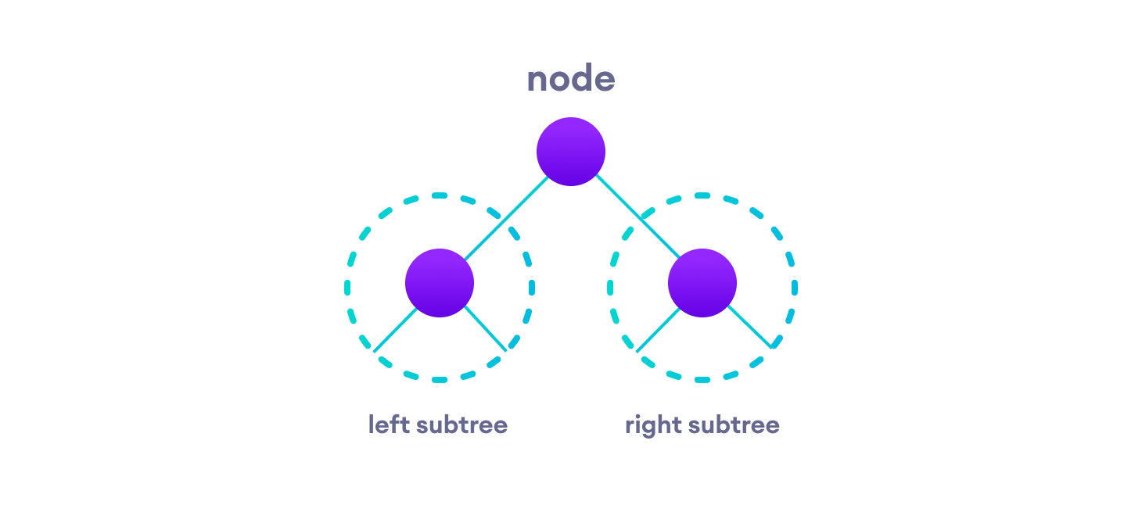
Inorder traversal
First, visit all the nodes in the left subtree
Then the root node
Visit all the nodes in the right subtree
Preorder traversal
Visit root node
Visit all the nodes in the left subtree
Visit all the nodes in the right subtree
Postorder traversal
Visit all the nodes in the left subtree
Visit all the nodes in the right subtree
Visit the root node

Slide 8
Binary Tree
A binary tree is a tree data structure in which each parent node can have at most two children. Each node of a binary tree consists of three items:
data item
address of left child
address of right child

Slide 9
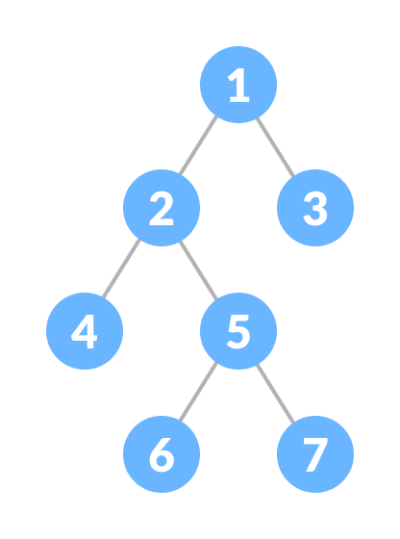
Types of Binary Tree
1. Full Binary Tree
A full Binary tree is a special type of binary tree in which every parent node/internal node has either two or no children.

Slide 10
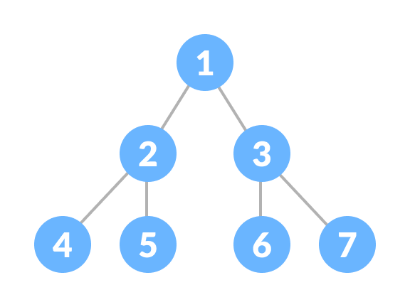
2. Perfect Binary Tree
A perfect binary tree is a type of binary tree in which every internal node has exactly two child nodes and all the leaf nodes are at the same level.

Slide 11
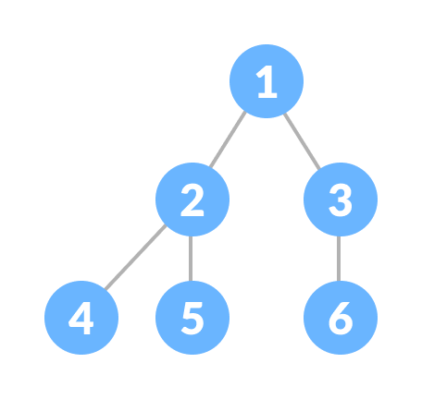
3. Complete Binary Tree
A complete binary tree is just like a full binary tree, but with two major differences
Every level must be completely filled
All the leaf elements must lean towards the left.
The last leaf element might not have a right sibling i.e. a complete binary tree doesn't have to be a full binary tree.

Slide 12
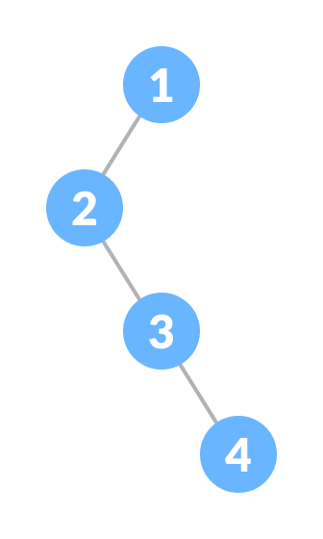
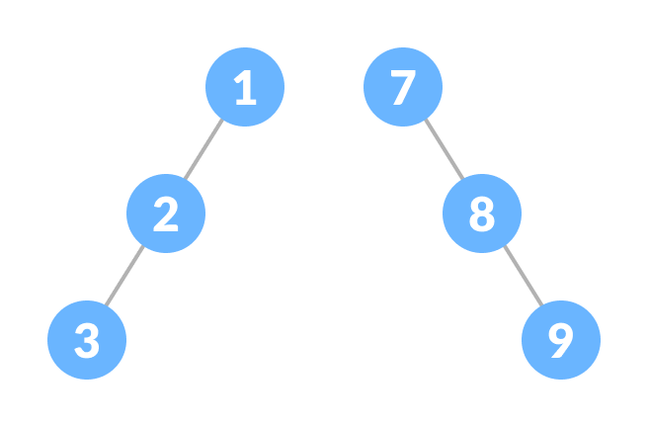
4. Degenerate or Pathological Tree
A degenerate or pathological tree is the tree having
a single child either left or right.
5. Skewed Binary Tree
A skewed binary tree is a pathological/degenerate tree in which the tree is either dominated by the left nodes or the right nodes. Thus, there are two types of skewed binary tree:
left-skewed binary tree and right-skewed binary tree.

Slide 13
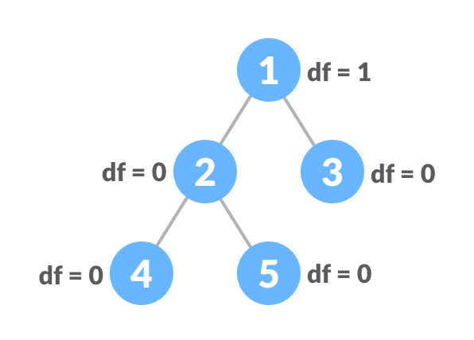
6. Balanced Binary Tree
It is a type of binary tree in which the difference between the height of the left and the right subtree for each node is either 0 or 1.

Slide 14
Binary Tree Applications
For easy and quick access to data
In router algorithms
To implement heap data structure.
Syntax tree

Slide 15
Binary Search Tree(BST)
Binary search tree is a data structure that quickly allows us to maintain a sorted list of numbers.
It is called a binary tree because each tree node has a maximum of two children.
It is called a search tree because it can be used to search for the presence of a number in
O(log n) time.
The properties that separate a binary search tree from a regular binary tree is
All nodes of left subtree are less than the root node
All nodes of right subtree are more than the root node
Both subtrees of each node are also BSTs i.e. they have the above two properties

Slide 16
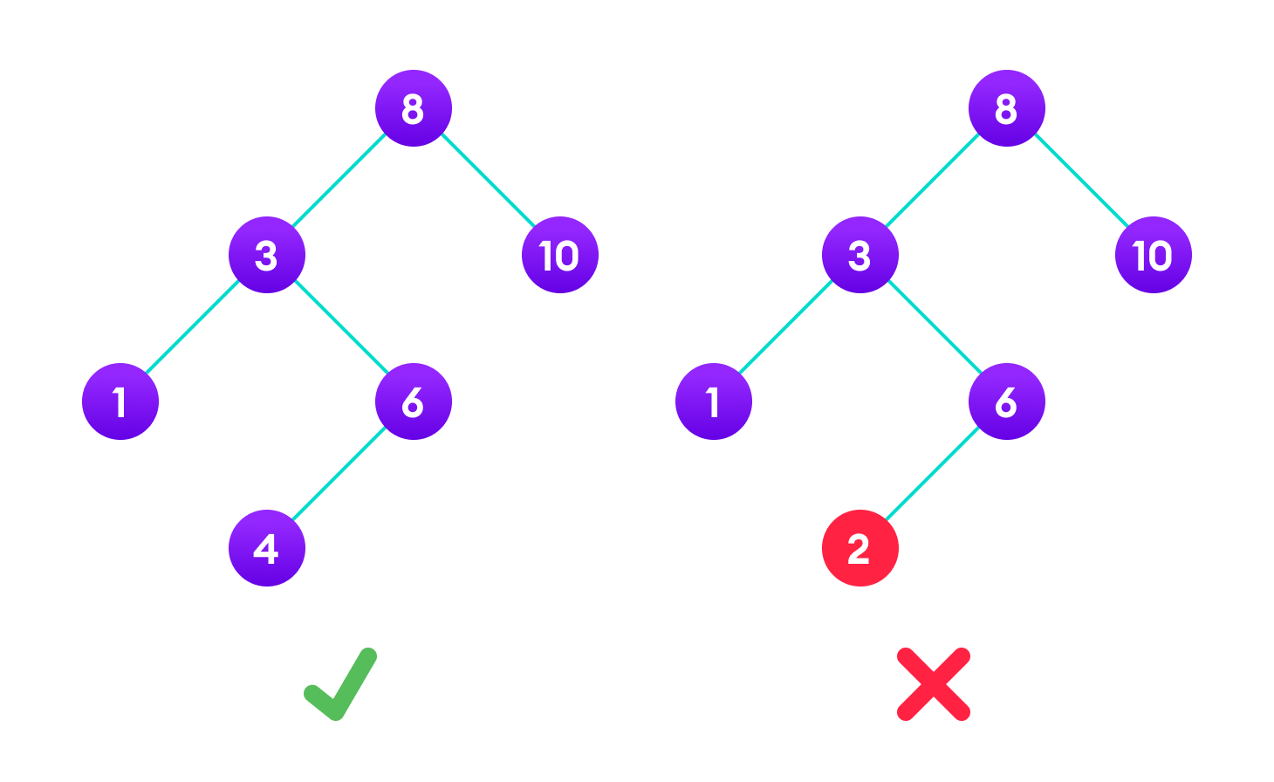
The binary tree on the right isn't a binary search tree because the right subtree of the node "3" contains a value smaller than it.

Slide 17
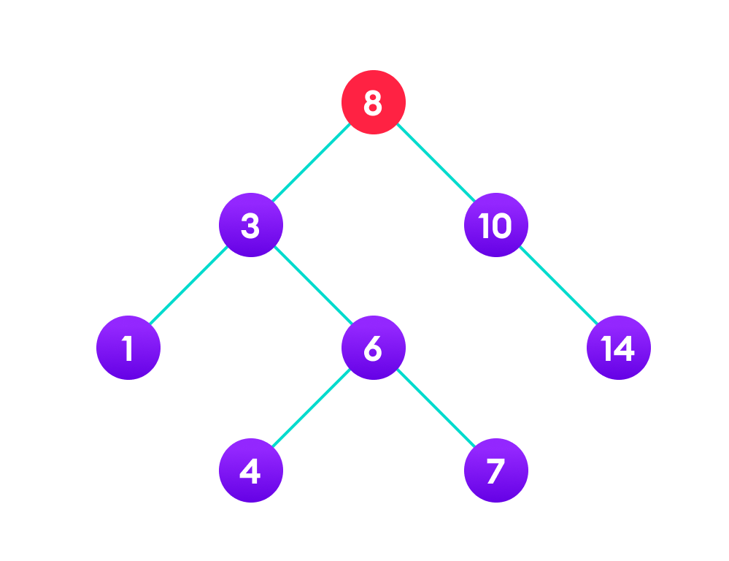
Search Operation The algorithm depends on the property of BST that if each left subtree has values below root and each right subtree has values above the root. If the value is below the root, we can say for sure that the value is not in the right subtree; we need to only search in the left subtree and if the value is above the root, we can say for sure that the value is not in the left subtree; we need to only search in the right subtree.

Slide 18
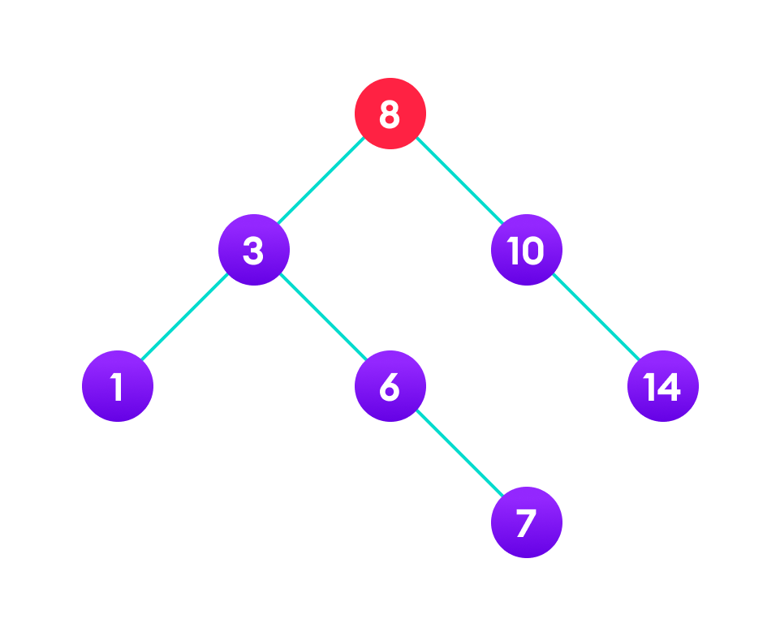
Insert Operation Inserting a value in the correct position is similar to searching because we try to maintain the rule that the left subtree is lesser than root and the right subtree is larger than root. We keep going to either right subtree or left subtree depending on the value and when we reach a point left or right subtree is null, we put the new node there.

Slide 19
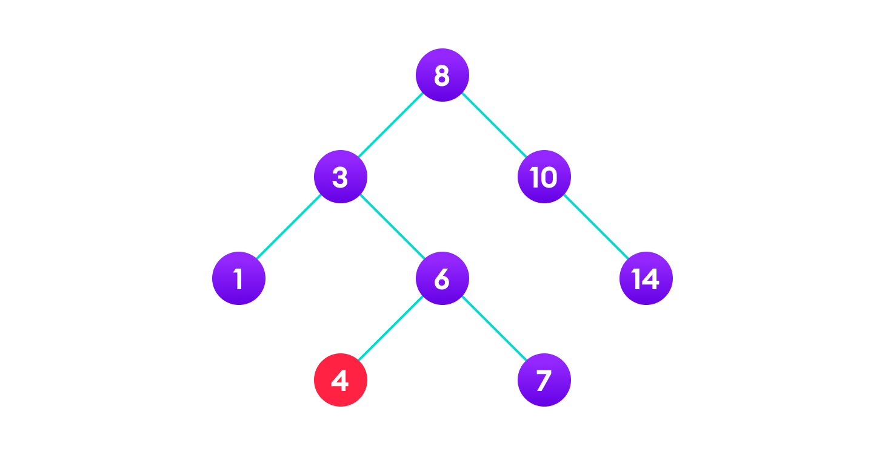
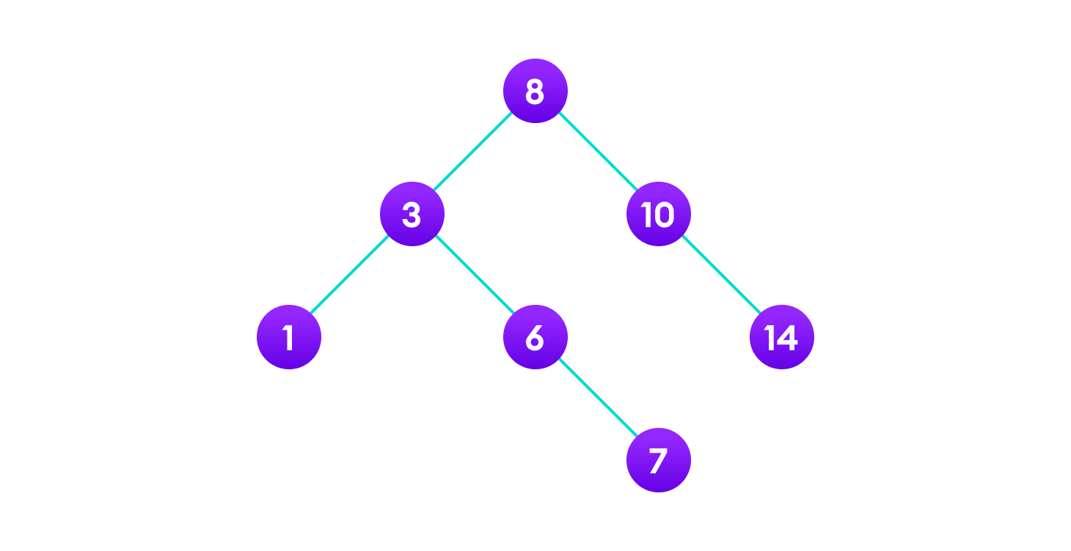
Deletion Operation There are three cases for deleting a node from a binary search tree. Case I In the first case, the node to be deleted is the leaf node. In such a case, simply delete the node from the tree.

Slide 20
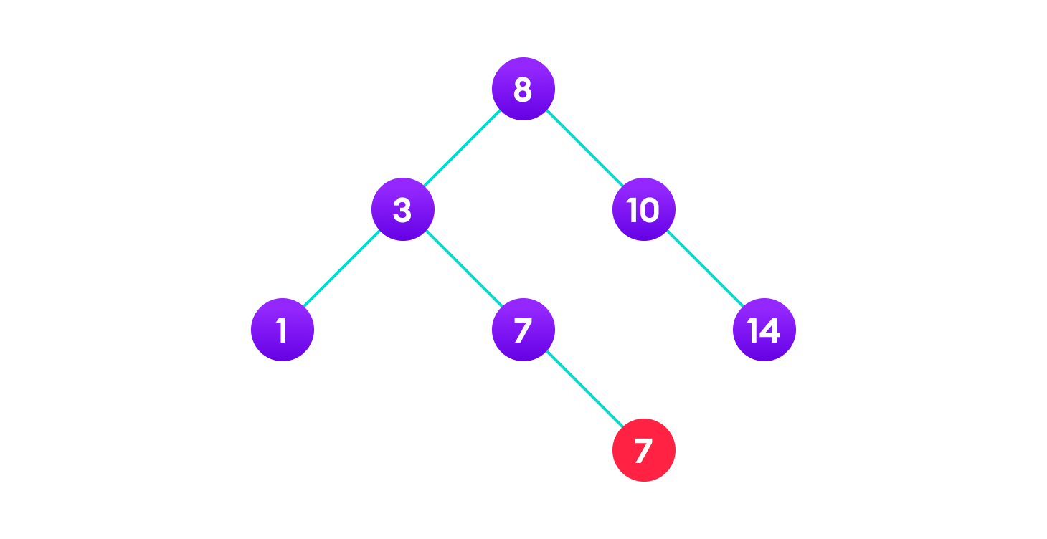
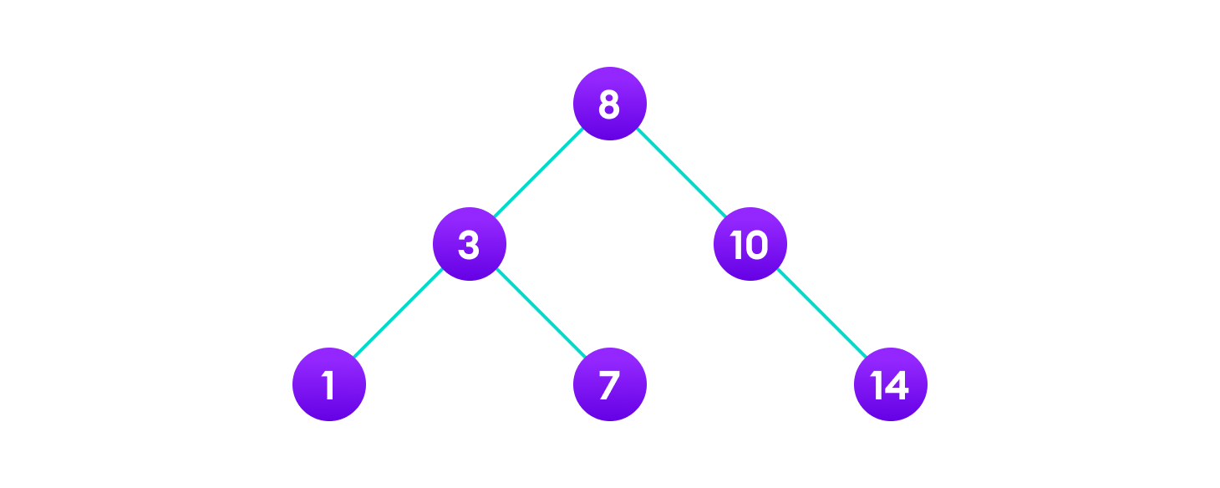
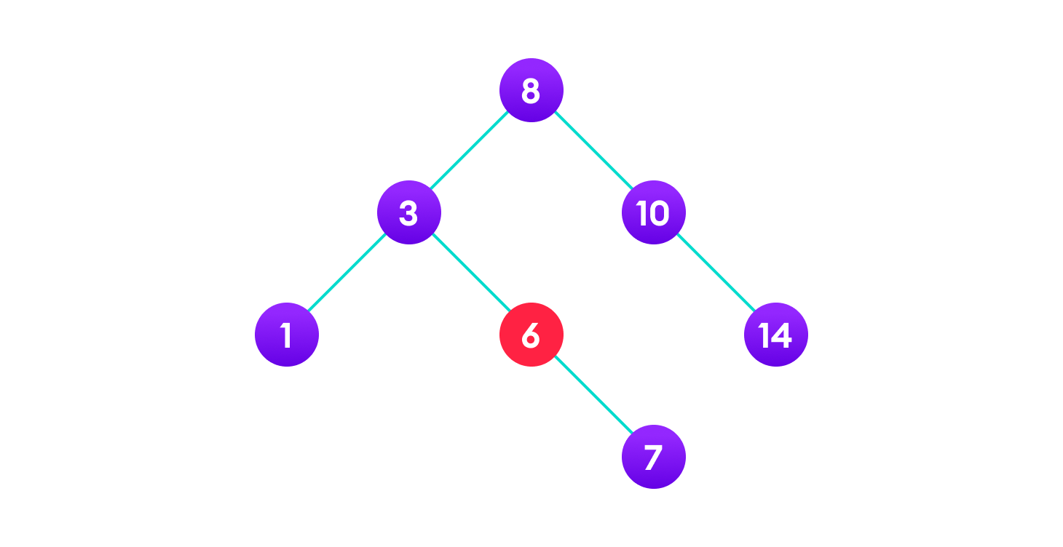
Case II In the second case, the node to be deleted lies has a single child node. In such a case follow the steps below: Replace that node with its child node. Remove the child node from its original position.

Slide 21
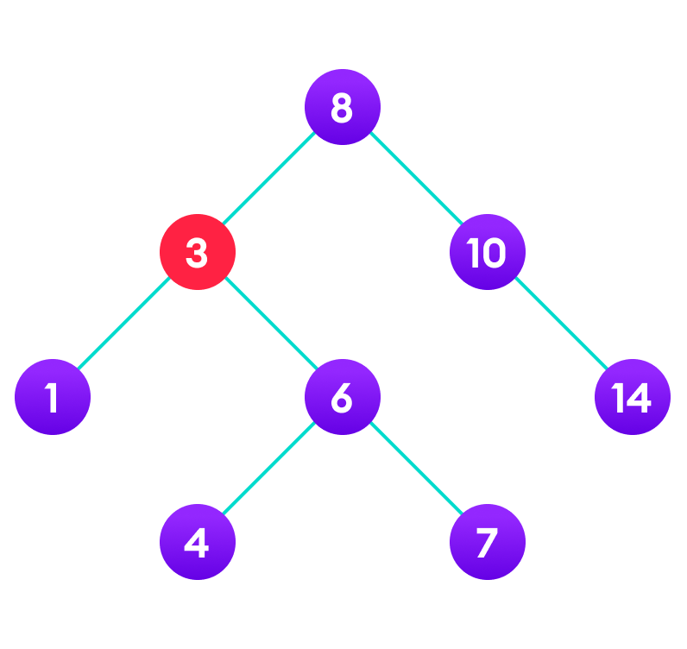

Case III In the third case, the node to be deleted has two children. In such a case follow the steps below: Get the inorder successor of that node. Replace the node with the inorder successor. Remove the inorder successor from its original position.

Slide 22
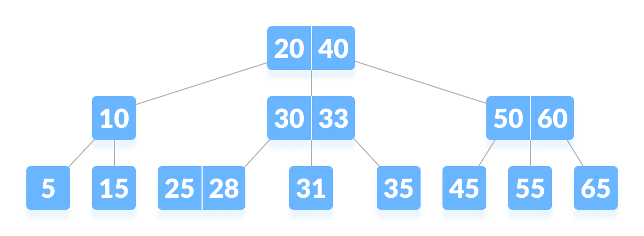
B-tree
B-tree is a special type of self-balancing search tree in which each node can contain more than one key and can have more than two children. It is a generalized form of the binary search tree.

Slide 23
B-tree Properties
All leaves are at the same level.
The root has at least 2 children and contains a minimum of 1 key.
Each node except root can have at most n children and at least n/2 children.
All keys of a node are sorted in increasing order. The child between two keys k1 and k2 contains all keys in the range from k1 and k2.
B-Tree grows and shrinks from the root which is unlike Binary Search Tree. Binary Search Trees grow downward and also shrink from downward.
Like other balanced Binary Search Trees, time complexity to search, insert and delete is O(log n).
Insertion of a Node in B-Tree happens only at Leaf Node.

Slide 24
B tree
A B tree of order m (m = 3)contains all the properties of an M way tree. In addition, it contains the following properties.
Every node in a B-Tree contains at most m(3) children.
Every node in a B-Tree except the root node and the leaf node contain at least m/2 (3/2 = 2)children.
A node can contain a maximum of m-1 keys i.e 2
A node (except root node) should contain a minimum of (m/2)-1 keys i.e 1 key
The root nodes must have at least 2 nodes.
All leaf nodes must be at the same level.
It is not necessary that, all the nodes contain the same number of children but, each node must have m/2 (2) number of nodes.

Slide 25
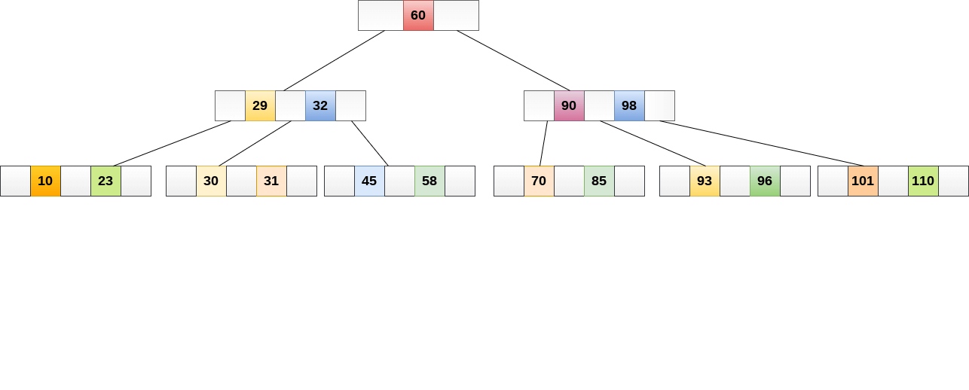
A B tree of order 4 is shown in the following image.

Slide 26
Create node in b-tree
# Create a node
class BTreeNode:
def __init__(self, leaf=False):
self.leaf = leaf
self.keys = []
self.child = []
# Tree
class BTree:
def __init__(self, t):
self.root = BTreeNode(True)
self.t = t

Slide 27
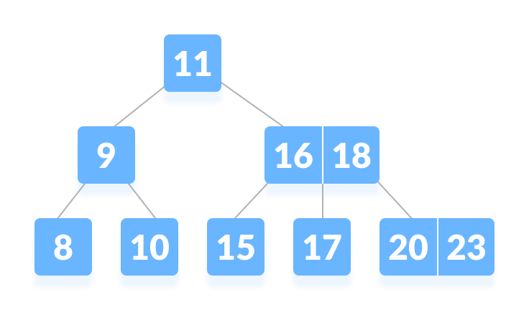
Searching an element in a B-tree

Slide 28
Searching in B tree
Searching
Searching for an element in a B-tree is the generalized form of searching an element in a Binary Search Tree. The following steps are followed.
Starting from the root node, compare k with the first key of the node. If k = the first key of the node, return the node and the index.
If k.leaf = true, return NULL (i.e. not found).
If k < the first key of the root node, search the left child of this key recursively.
If there is more than one key in the current node and k > the first key, compare k with the next key in the node. If k < next key, search the left child of this key (ie. k lies in between the first and the second keys). Else, search the right child of the key.
Repeat steps 1 to 4 until the leaf is reached.

Slide 29
Insertion into a B-tree
Inserting an element on a B-tree consists of two events: searching the appropriate node to insert the element and splitting the node if required.Insertion operation always takes place in the bottom-up approach.
Insertion Operation
If the tree is empty, allocate a root node and insert the key.
Update the allowed number of keys in the node.
Search the appropriate node for insertion.
If the node is full, follow the steps below.
Insert the elements in increasing order.
Now, there are elements greater than its limit. So, split at the median.
Push the median key upwards and make the left keys as a left child and the right keys as a right child.
If the node is not full, follow the steps below.
Insert the node in increasing order.

Slide 30
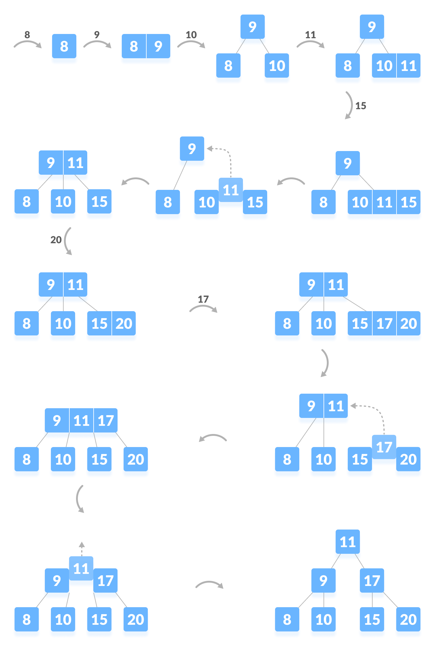

Slide 31
Deletion from a B-tree
Deleting an element on a B-tree consists of three main events: searching the node where the key to be deleted exists, deleting the key and balancing the tree if required.
While deleting a tree, a condition called underflow may occur. Underflow occurs when a node contains less than the minimum number of keys it should hold.
The terms to be understood before studying deletion operation are:
Inorder Predecessor The largest key on the left child of a node is called its inorder predecessor.
Inorder Successor The smallest key on the right child of a node is called its inorder successor.

Slide 32
Deletion Operation
There are three main cases for deletion operation in a B tree.
Case I
The key to be deleted lies in the leaf. There are two cases for it.
The deletion of the key does not violate the property of the minimum number of keys a node should hold. In the tree below, deleting 32 does not violate the above properties.

Slide 33
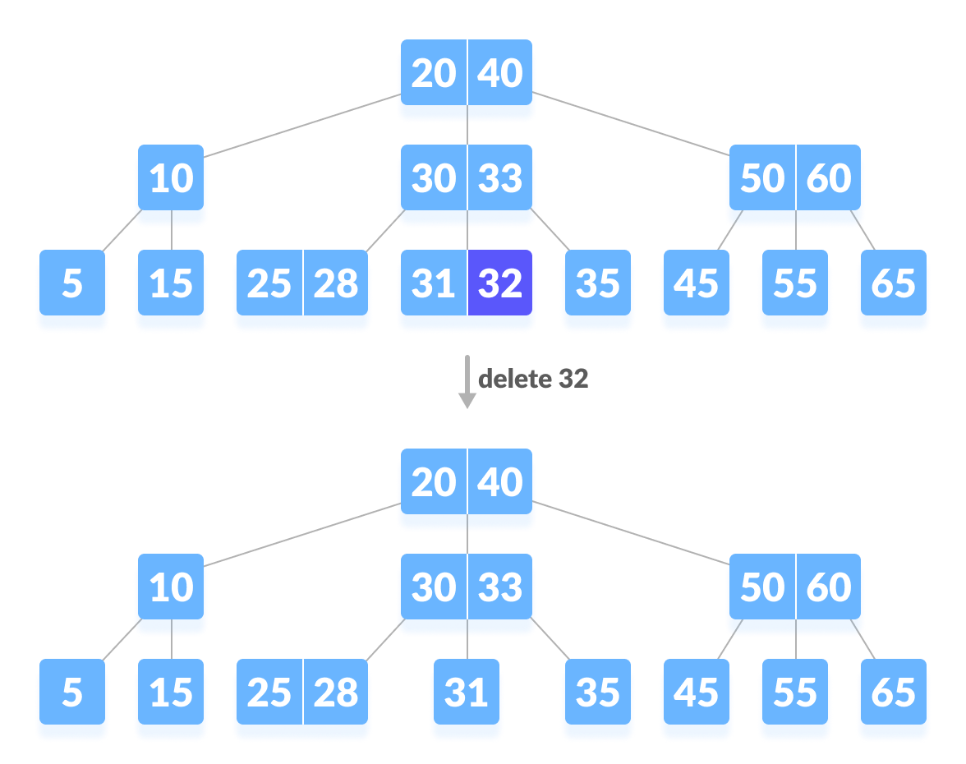

Slide 34
The deletion of the key violates the property of the minimum number of keys a node should hold. In this case, we borrow a key from its immediate neighboring sibling node in the order of left to right. First, visit the immediate left sibling. If the left sibling node has more than a minimum number of keys, then borrow a key from this node. Else, check to borrow from the immediate right sibling node. In the tree below, deleting 31 results in the above condition. Let us borrow a key from the left sibling node.

Slide 35
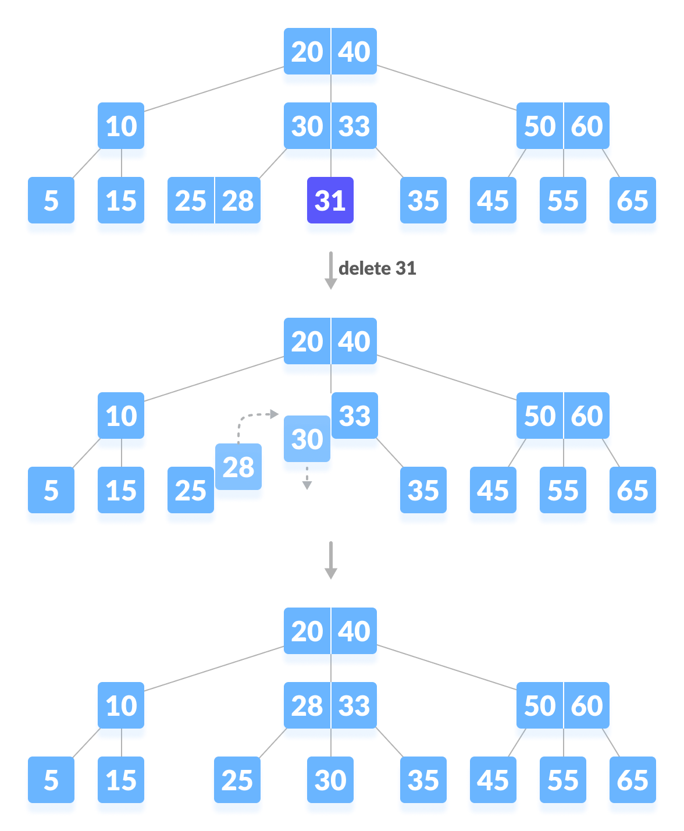

Slide 36
Case II
If the key to be deleted lies in the internal node, the following cases occur.
The internal node, which is deleted, is replaced by an inorder predecessor if the left child has more than the minimum number of keys.
The internal node, which is deleted, is replaced by an inorder successor if the right child has more than the minimum number of keys.
If either child has exactly a minimum number of keys then, merge the left and the right children.
After merging if the parent node has less than the minimum number of keys then, look for the siblings as in Case I.

Slide 37
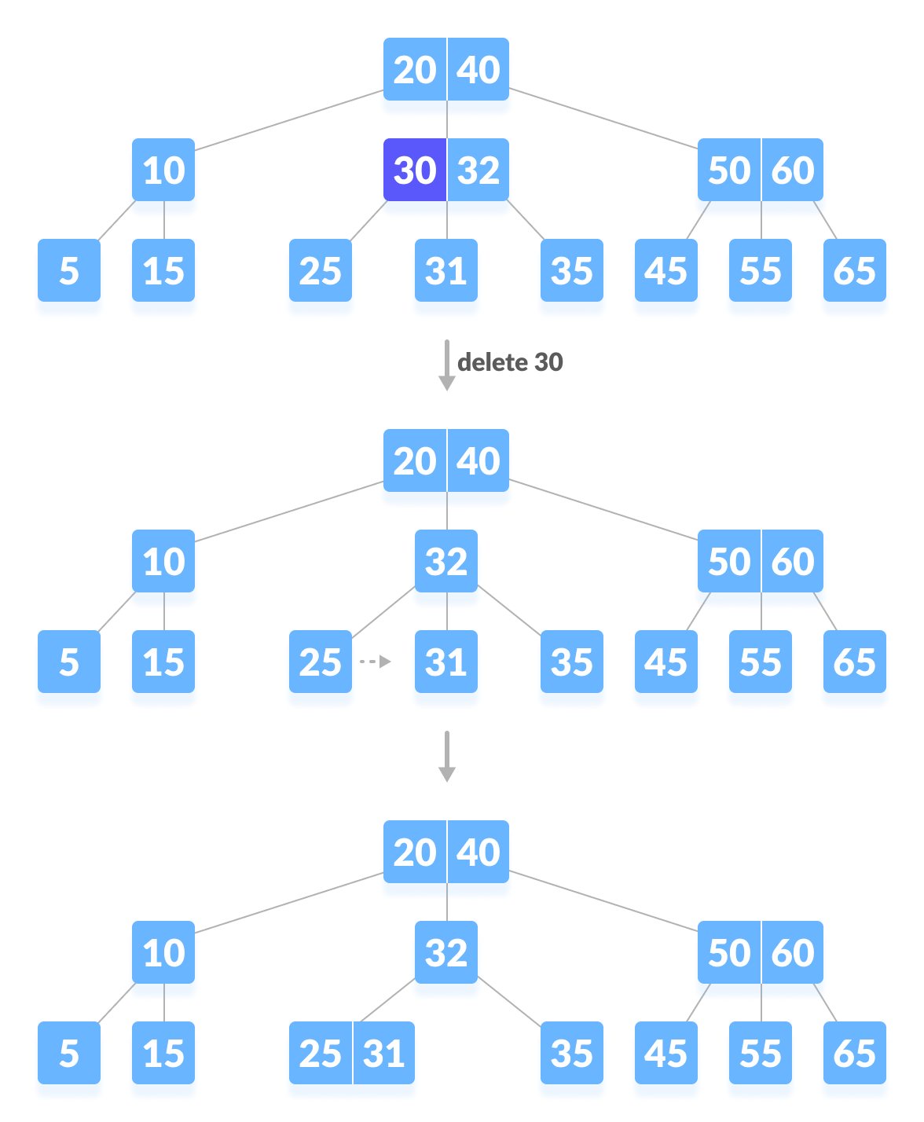

Slide 38
Case III
In this case, the height of the tree shrinks.
If the target key lies in an internal node, and the deletion of the key leads to a fewer number of keys in the node (i.e. less than the minimum required), then look for the inorder predecessor and the inorder successor.
If both the children contain a minimum number of keys then, borrowing cannot take place. This leads to Case II(3) i.e. merging the children.
Again, look for the sibling to borrow a key. But, if the sibling also has only a minimum number of keys then, merge the node with the sibling along with the parent. Arrange the children accordingly (increasing order).

Slide 39
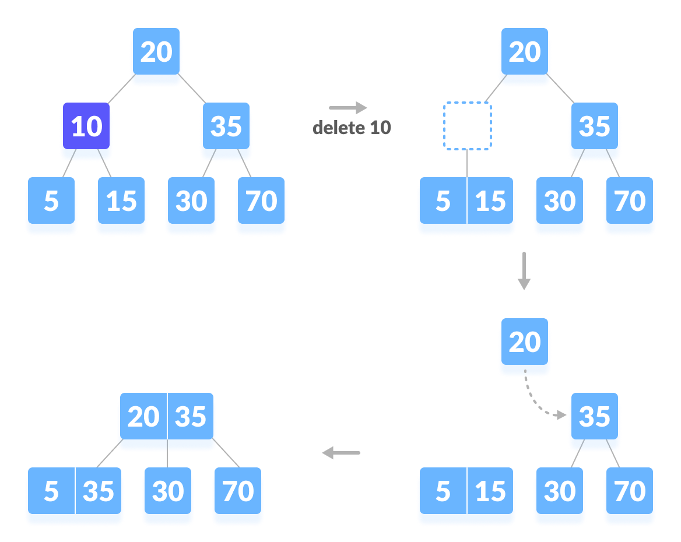

Slide 40
B+ Tree
In order, to implement dynamic multilevel indexing, B-tree and B+ tree are generally employed. The drawback of B-tree used for indexing, however is that it stores the data pointer (a pointer to the disk file block containing the key value), corresponding to a particular key value, along with that key value in the node of a B-tree. This technique, greatly reduces the number of entries that can be packed into a node of a B-tree, thereby contributing to the increase in the number of levels in the B-tree, hence increasing the search time of a record
B+ tree eliminates the above drawback by storing data pointers only at the leaf nodes of the tree. Thus, the structure of leaf nodes of a B+ tree is quite different from the structure of internal nodes of the B tree. It may be noted here that, since data pointers are present only at the leaf nodes, the leaf nodes must necessarily store all the key values along with their corresponding data pointers to the disk file block, in order to access them. Moreover, the leaf nodes are linked to provide ordered access to the records. The leaf nodes, therefore form the first level of index, with the internal nodes forming the other levels of a multilevel index. Some of the key values of the leaf nodes also appear in the internal nodes, to simply act as a medium to control the searching of a record.
From the above discussion it is apparent that a B+ tree, unlike a B-tree has two orders, ‘a’ and ‘b’, one for the internal nodes and the other for the external (or leaf) nodes.

